Slide 1
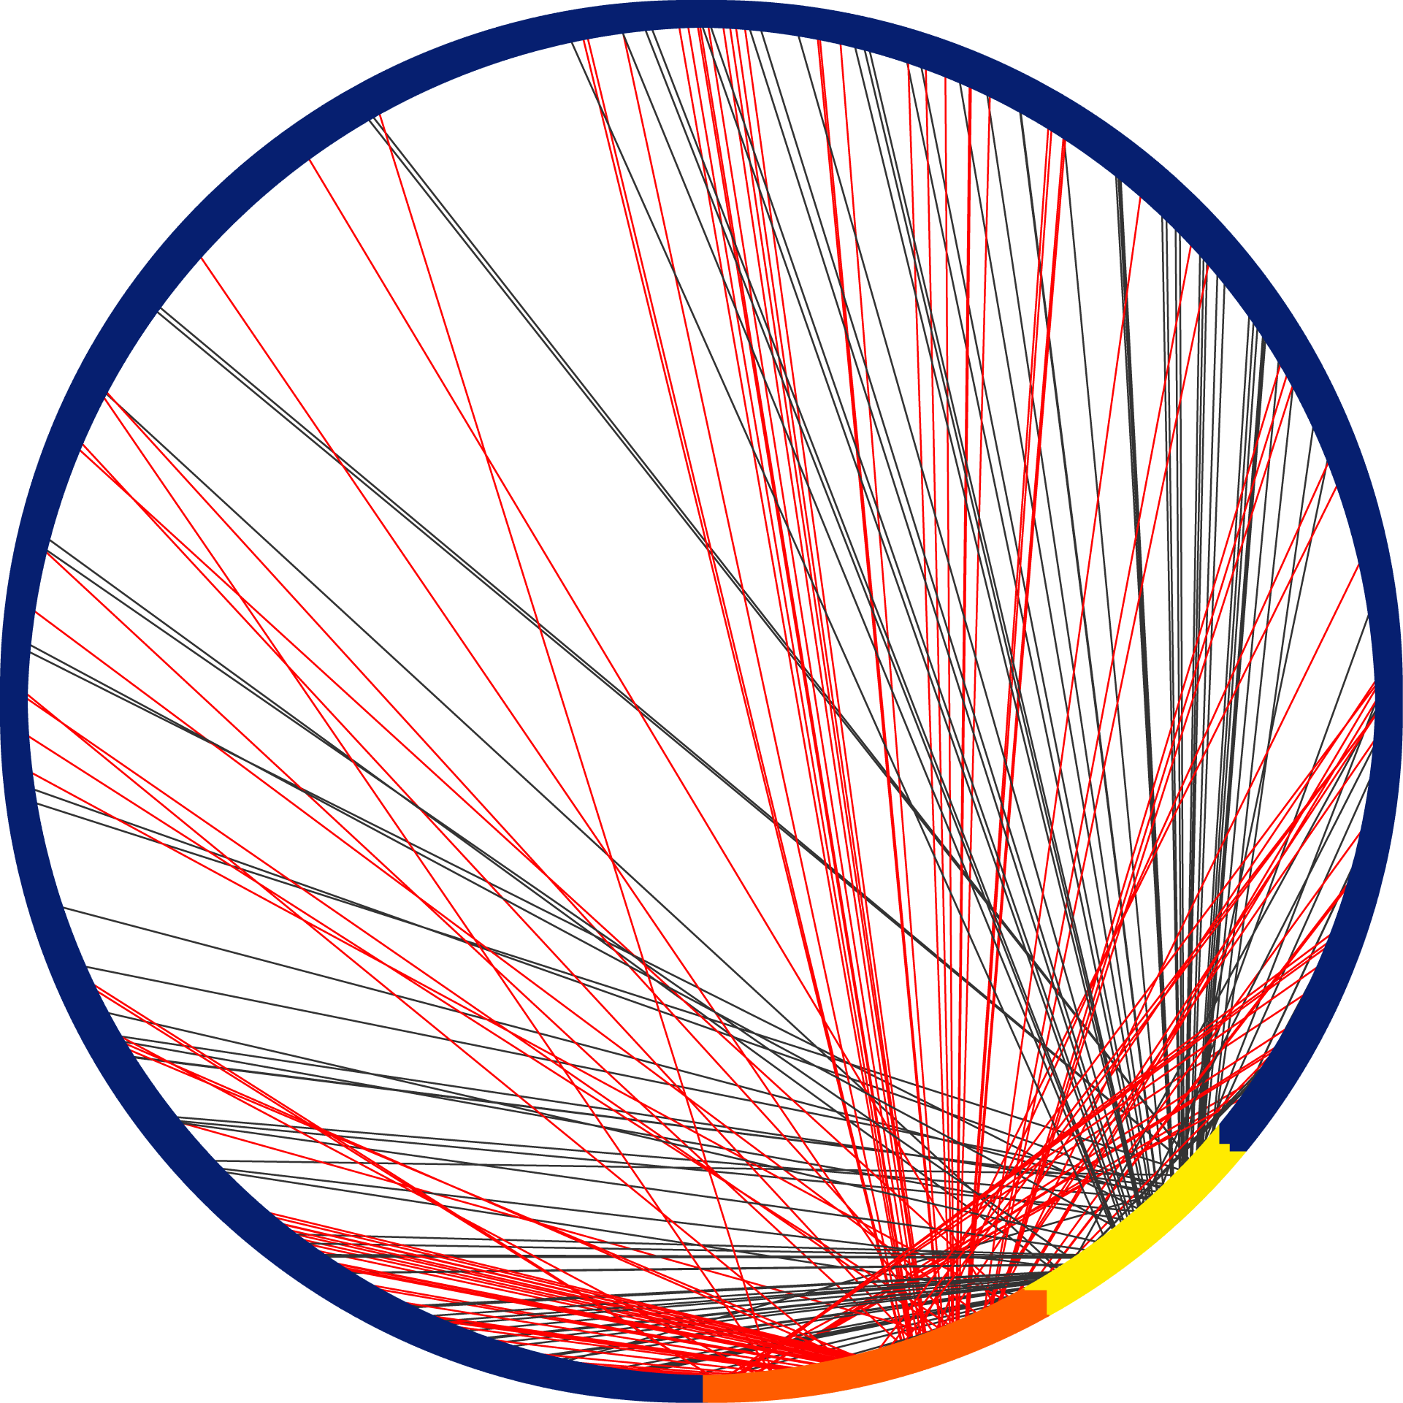


Sources of Experimental Function Annotation in UniProt-GOA, Implications for Function Prediction
Alexandra M Schnoes, Alexander W Thorman, Iddo Friedberg

Slide 2
The Importance of Experimentally Characterized Proteins
Furthers experimental progress in basic, biomedical and clinical science
Computation:
Gold standard data test function prediction algorithms
Use in function prediction

Slide 3
The Composition of Experimental Data Impacts Function Prediction
Bias
Increases error
Decreases utility
One potential source of data composition bias:
Overrepresentation of certain experimental methods high-throughput protein function characterization
Source bias: Few papers, many proteins?
Predominance of certain types of annotations?
Notes:
Proteomics
Protein-protein interactions
Expression data
Microscopy

Slide 4
Examine the UniProt-Gene Ontology Annotation (GOA) Database
Purpose:
Determine whether high-annotating papers are biasing the composition of GOA annotations
If a bias exists, to what level?
December 2011, http://www.ebi.ac.uk/GOA/
Notes:
Premier experimental database
Informs Swiss-Prot/shown to be the one the highest quality protein db out there
Three ontologies (covers 3 domains)
----- Meeting Notes (7/9/12 12:04) -----
Focused specifically on papers that annotate the most number of proteins
say 'annotate the most papers'

Slide 5
Examine the UniProt-Gene Ontology Annotation (GOA) Database
Experimental Evidence Codes in GOA | Count
All | 522,208
IEP (Inferred from Expression Pattern) | 13,972
IPI (Inferred from Physical Interaction) | 63,832
IMP (Inferred from Mutant Phenotype) | 184,084
EXP (Inferred from Experiment) | 31
IGI (Inferred from Genetic Interaction) | 26,522
IDA (Inferred from Direct Assay) | 233,767
December 2011, http://www.ebi.ac.uk/GOA/
Notes:
Premier experimental database
Informs Swiss-Prot/shown to be the one the highest quality protein db out there
Three ontologies (covers 3 domains)
IDA—All CCO
IPI—MFO

Slide 6
Examine the UniProt-Gene Ontology Annotation (GOA) Database
Experimental Evidence Codes in GOA | Count
All | 522,208
IEP (Inferred from Expression Pattern) | 13,972
IPI (Inferred from Physical Interaction) | 63,832
IMP (Inferred from Mutant Phenotype) | 184,084
EXP (Inferred from Experiment) | 31
IGI (Inferred from Genetic Interaction) | 26,522
IDA (Inferred from Direct Assay) | 233,767
December 2011, http://www.ebi.ac.uk/GOA/
Notes:
Premier experimental database
Informs Swiss-Prot/shown to be the one the highest quality protein db out there
Three ontologies (covers 3 domains)
----- Meeting Notes (7/9/12 12:04) -----
abbreviations, ontology
GO ontologies

Slide 7
Top 50 Papers— Annotate the Most Proteins in GOA
 | No. of Annotated Proteins | No. of GOA Annotations | Species | Majority Ontology | Majority Evidence Code
1 | 4937 | 11050 | Human | CCO | IDA
2 | 4247 | 7046 | Schizosaccharomyces pombe | CCO | IDA
3 | 2412 | 2412 | Mouse | CCO | IDA
4 | 1791 | 5918 | Caenorhabditis elegans | BPO | IMP
5 | 1406 | 1863 | Saccharomyces cerevisiae S288c | CCO | IDA
6 | 1251 | 1251 | Arabidopsis thaliana | CCO | IDA
7 | 1205 | 1476 | Caenorhabditis elegans | BPO | IMP
… | … | … | … | … | …
50 | 241 | 263 | Arabidopsis thaliana | CCO | IDA
a

Slide 8
Top 50 Papers— Annotate the Most Proteins in GOA
a

Slide 9
Top 50 Papers— Annotate the Most Proteins in GOA
Ontology | Papers | Ev. Codes
CCO | 30 | IDA
BPO | 17 | IDA, IEP, IMP
MFO | 3 | IPI
Annotation Coverage of Total |  | 12%
a

Slide 10
6/9 Species > 10% Annotation Coverage
Notes:
Variable species coverage

Slide 11
Single Papers Can Greatly Increase Coverage
Papers sorted by number of annotations, top 50 in each species
Notes:
----- Meeting Notes (7/9/12 12:04) -----
-foot note
5/10/20/

Slide 12
What are the coverage propensities for common terms in the global top 50 papers?
A. thaliana
% Annotation Coverage, Relative to Each Species

Slide 13
S. cerevisiae
S. pombe
Certain terms predominantly occur in high-annotating papers
M. tuberculosis
Mouse
Human
D. melanogaster
D. discoideum
C. elegans
A. thaliana
Notes:
18/39 Listed Terms Populated Over 30%

Slide 14
S. cerevisiae
S. pombe
Certain terms predominantly occur in high-annotating papers
Terms are repeated over the different species (terms used twice or more are highlighted)
M. tuberculosis
Mouse
Human
D. melanogaster
D. discoideum
C. elegans
A. thaliana

Slide 15
How often do we annotate the same proteins?
Notes:
Sequence diversity

Slide 16
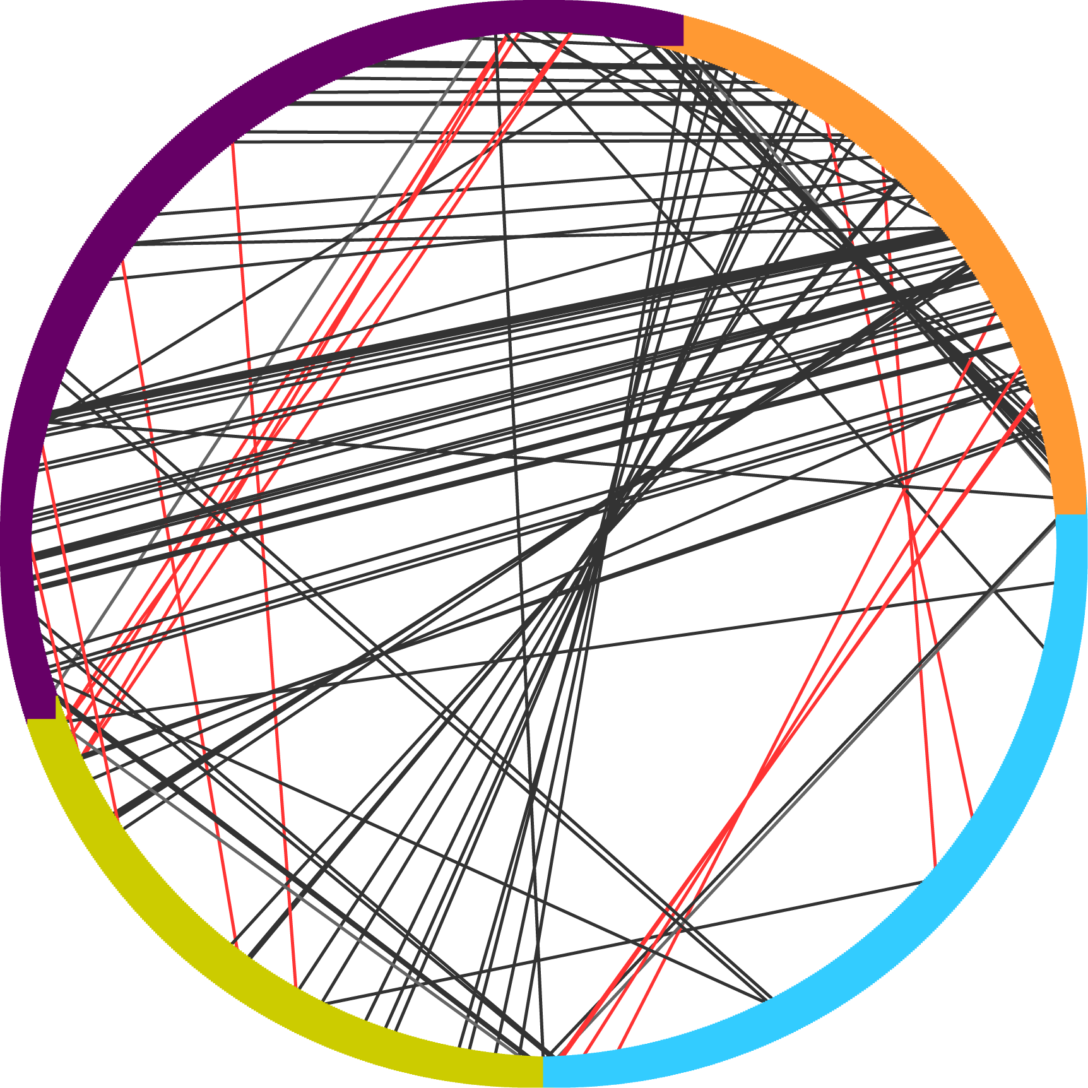
Top 50 Papers— Sequence Identity Between Papers
D. melanogaster (1217 sequences)
Notes:
----- Meeting Notes (7/9/12 12:04) -----
Arrow around the edge/ sequences/ for each paper/highlight
do a key!!
number of sequences…. or percentage….
A way I've come up with,
Not the the same terms!!!!

Slide 17
Top 50 Papers— Sequence Identity Between Papers
Paper, 243 sequences
Paper, 413 sequences
Paper, 319 sequences
Paper, 242 sequences
D. melanogaster (1217 sequences)
Notes:
NOTE: 243/should be 244… what happened there?

Slide 18
Top 50 Papers— Sequence Identity Between Papers
Paper, 243 sequences
Paper, 413 sequences
Paper, 319 sequences
Paper, 242 sequences
D. melanogaster (1217 sequences)
100% Sequence ID
Different Ontology
Same Ontology

Slide 19
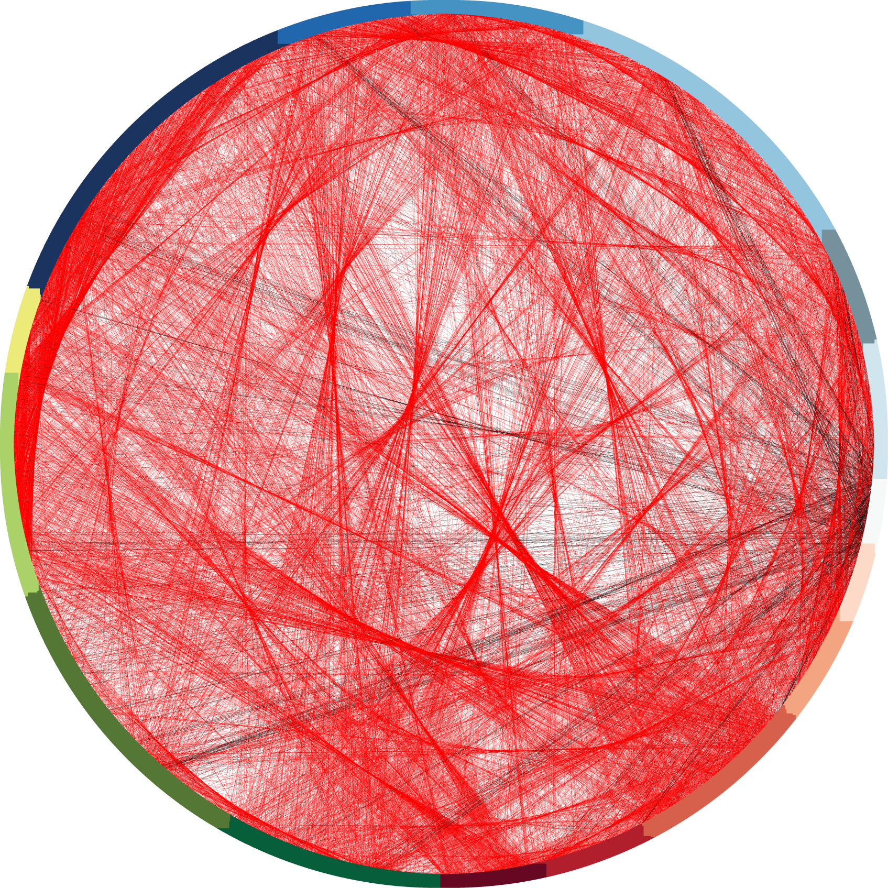
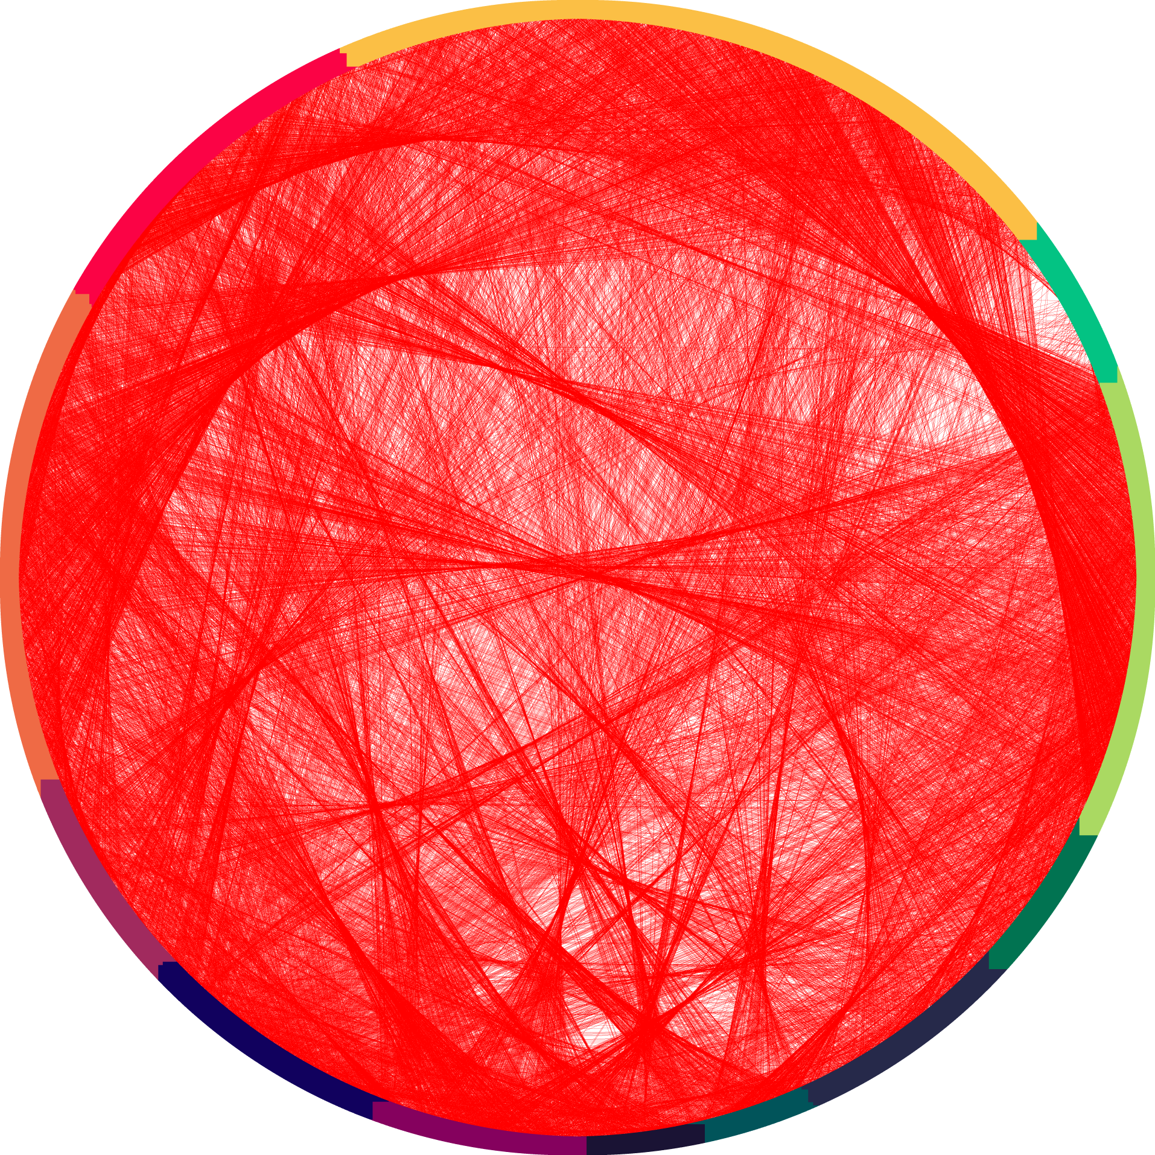
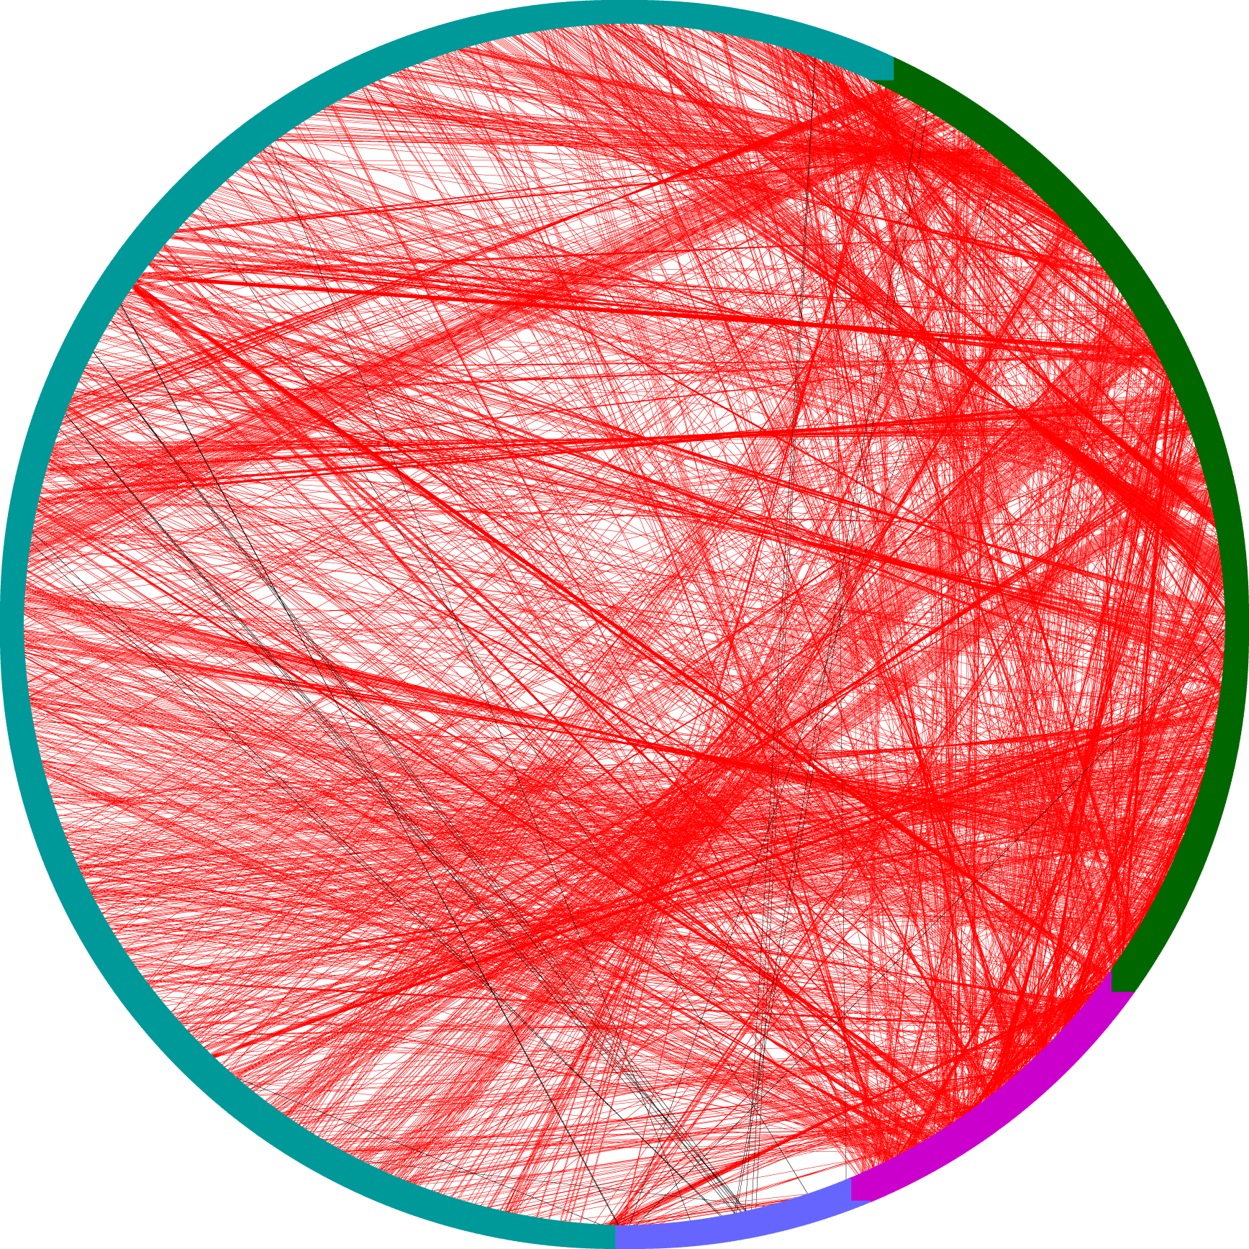
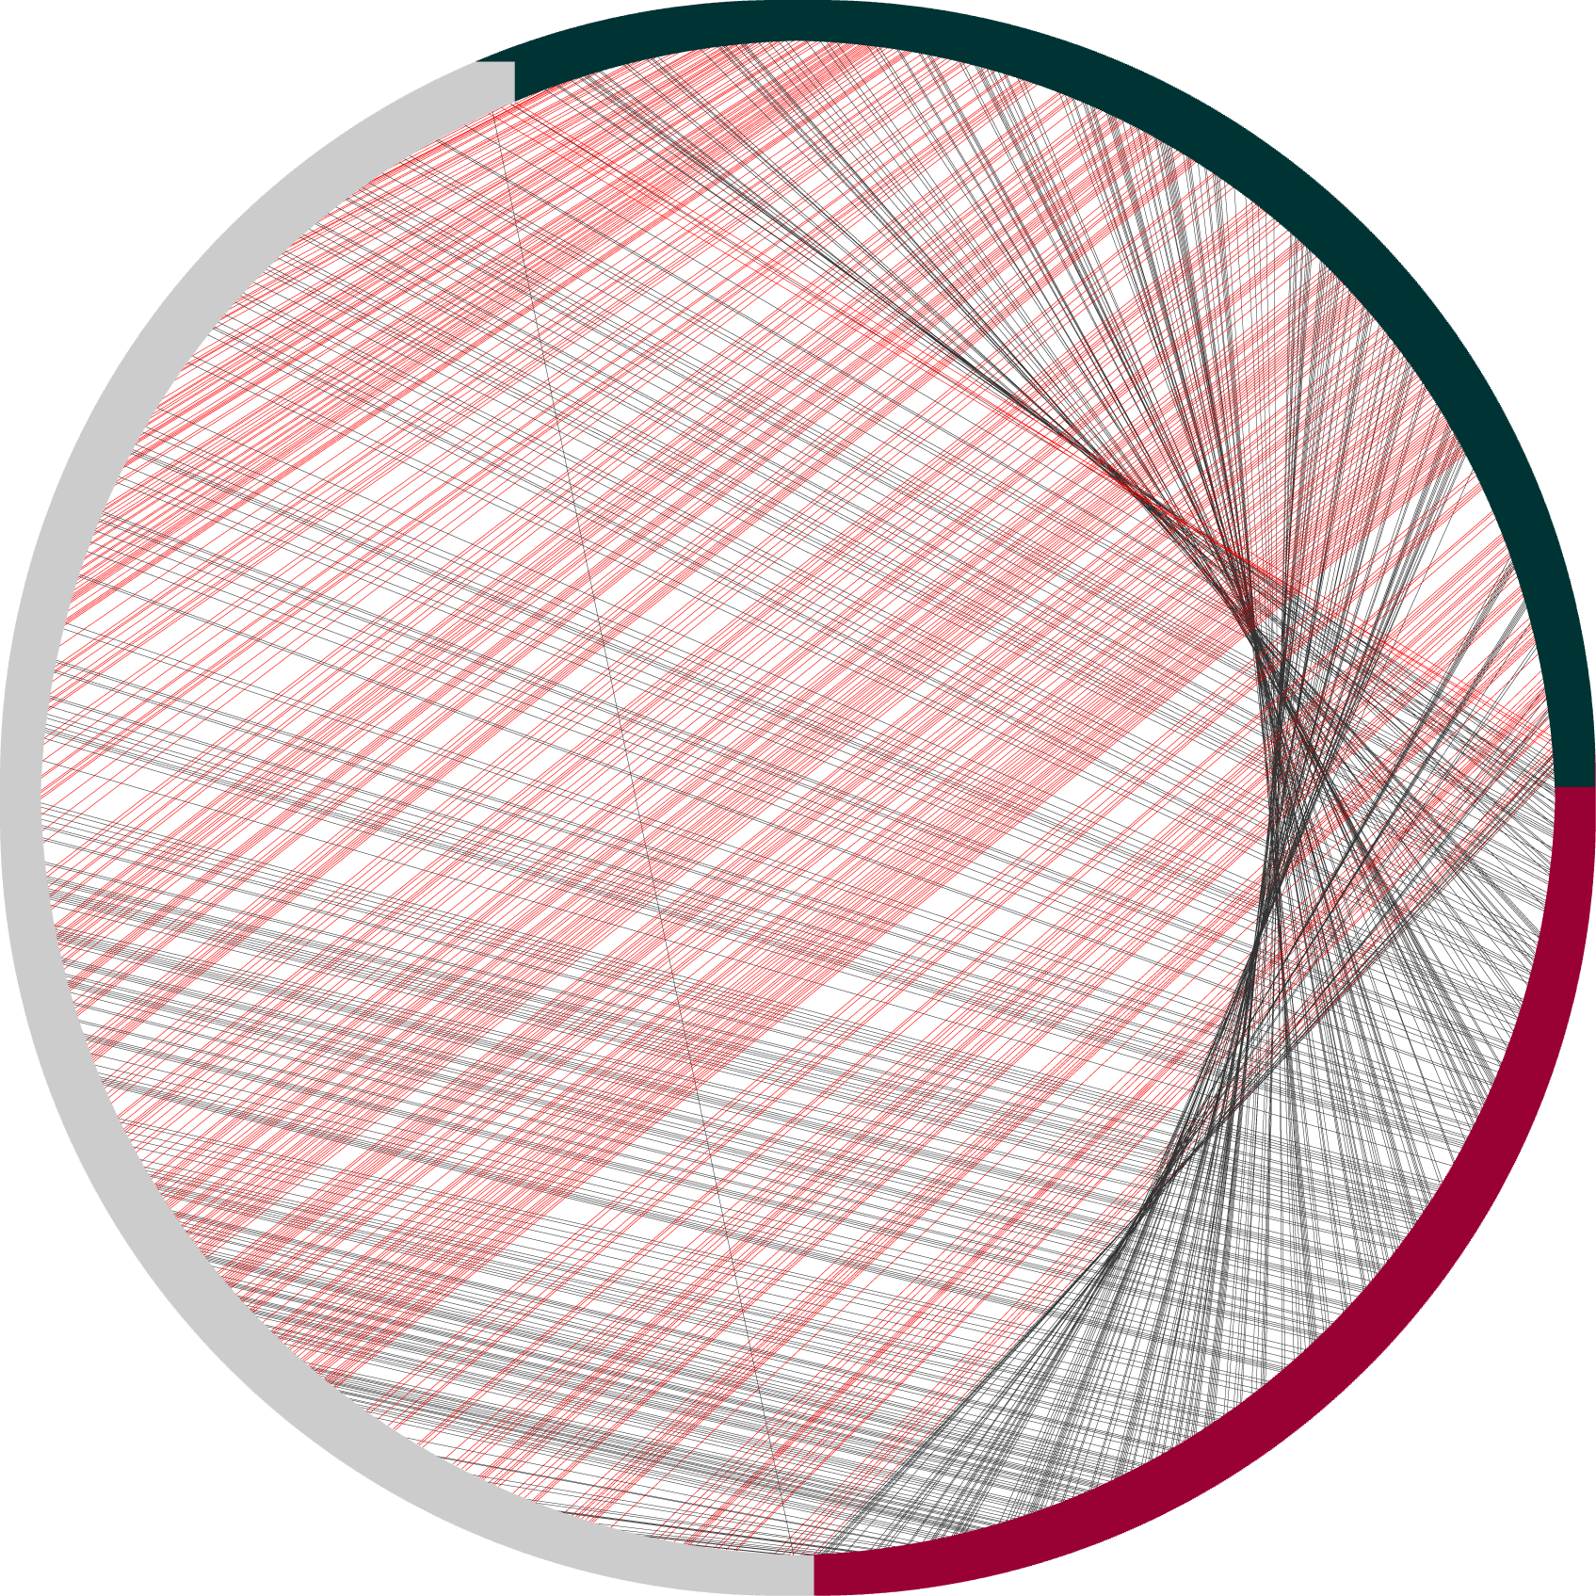
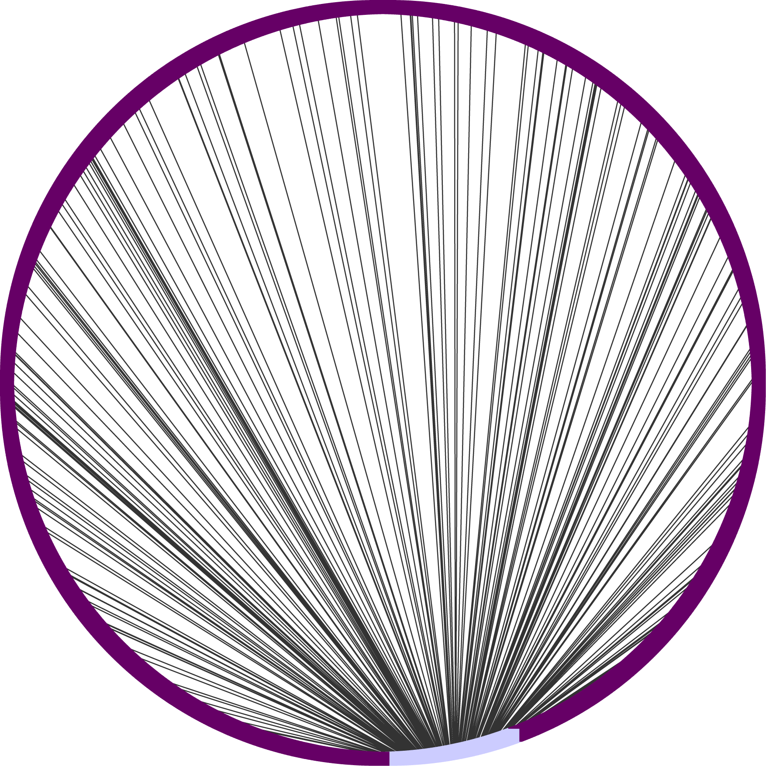
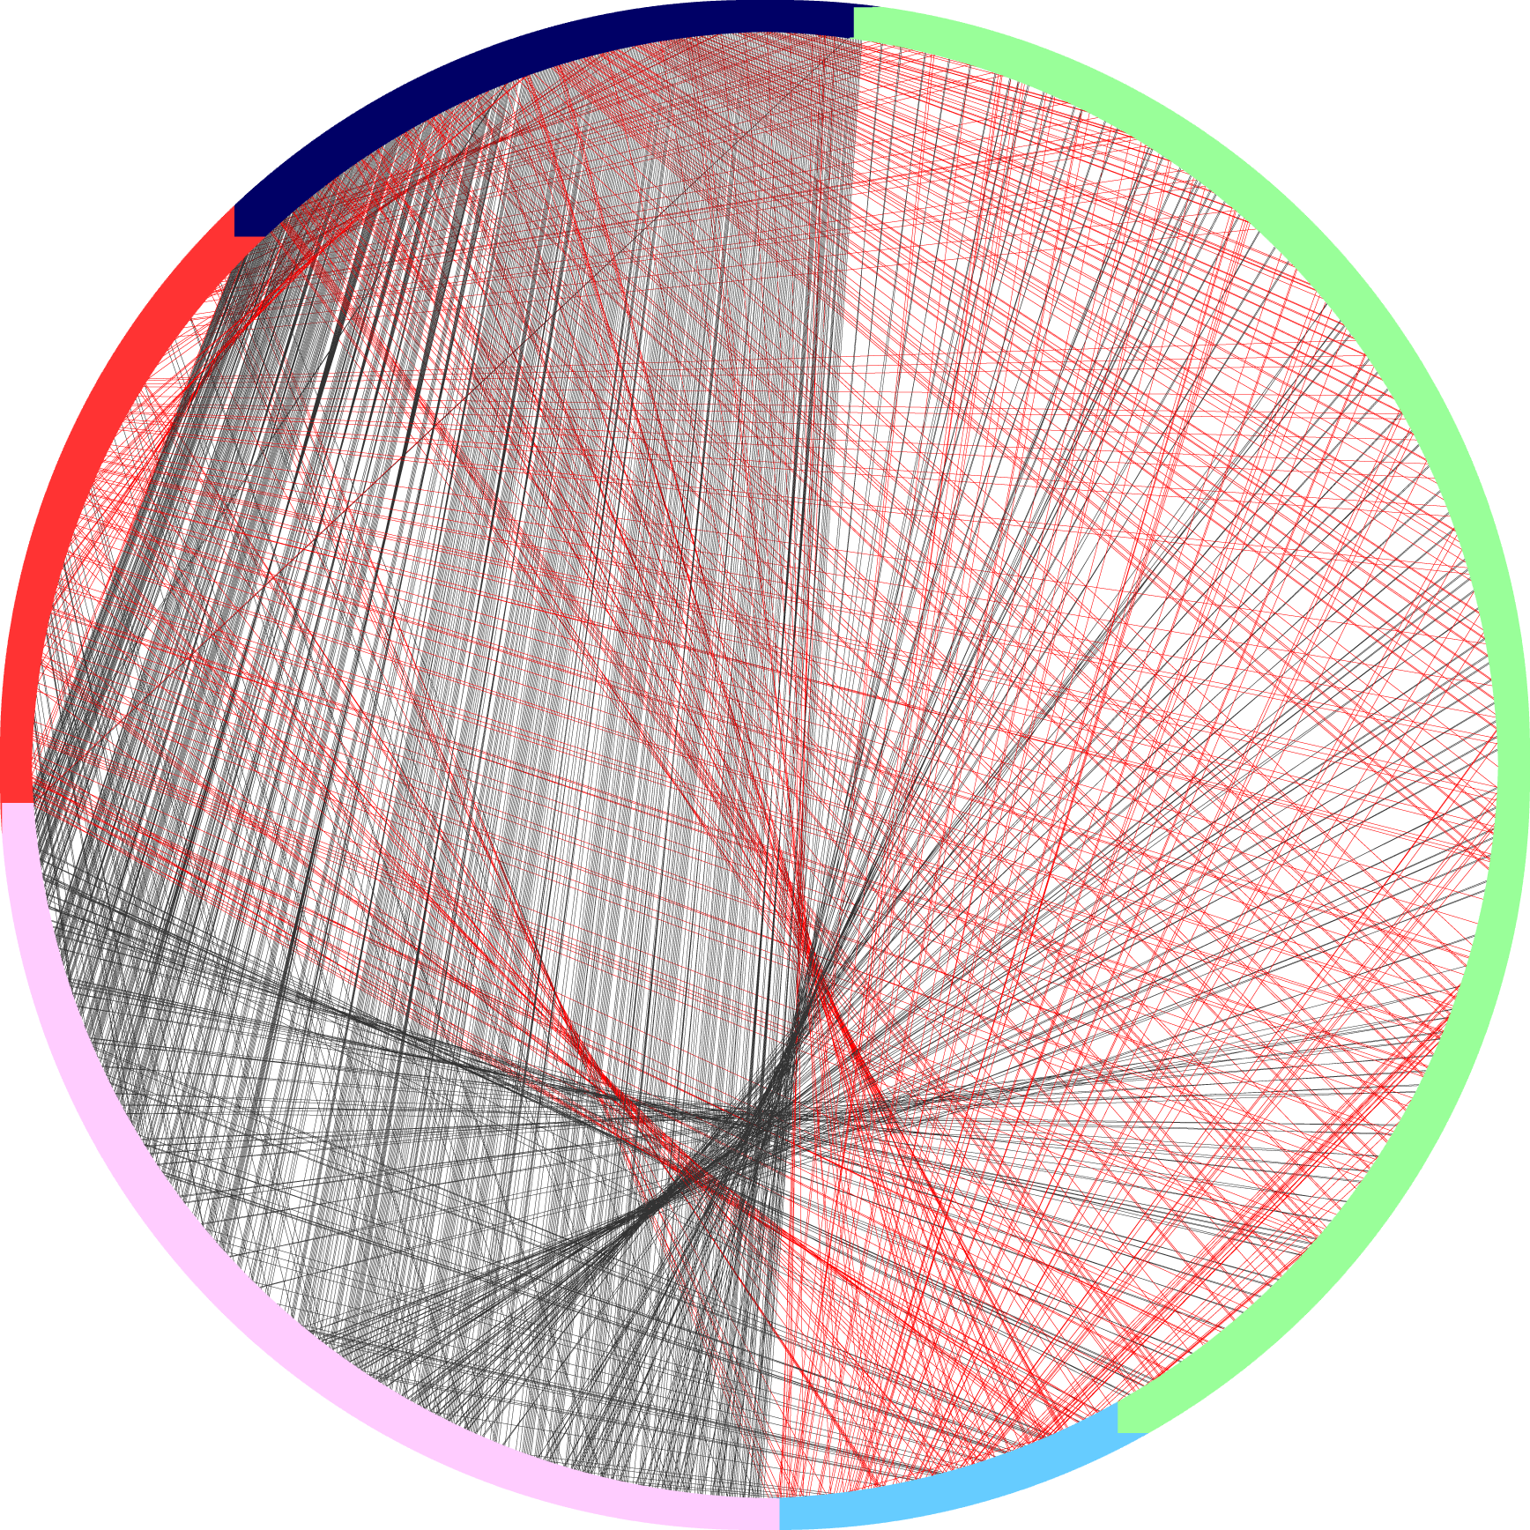
High Redundancy, Often in Same Ontology
A. thaliana (8879)
C. elegans (8416)
D. melanogaster (1217)
Human (5593)
Mouse (4220)
M. tuberculosis (2351)
S. pombe (4502)
S. cerevisiae (3542)
Different Ontology
Same Ontology
Notes:
----- Meeting Notes (7/9/12 12:04) -----
raises the question… is there bias…
STrong evidence… source bias elegans/thaliana/mouse….
putting the total # of proteins

Slide 20
Redundancy from 95-100% Sequence Identity
Species | Total Sequences | No. Clusters 100% | % Redundant | No. Clusters 95% | % Redundant
A. thaliana | 8879 | 4694 | 47% | 4595 | 48%
C. elegans | 8416 | 3338 | 60% | 3292 | 61%
D. melanogaster | 1217 | 1003 | 18% | 767 | 37%
Human | 5593 | 4509 | 19% | 3748 | 33%
M. tuberculosis | 2351 | 1702 | 28% | 1700 | 28%
Mouse | 4220 | 2273 | 46% | 1813 | 57%
S. cerevisiae | 3542 | 2550 | 28% | 2546 | 28%
S. pombe | 4502 | 4281 | 5% | 4253 | 6%

Slide 21
Conclusions
In certain species, annotation composition bias
Single papers have large impact on annotation coverage
Repeated use of same GO terms
High-throughput papers typically annotate the same set of sequences
Notes:
----- Meeting Notes (7/9/12 12:04) -----
source bias…. potential source bias

Slide 22
Implications for Function Prediction
Not all experimental annotations in GOA are ‘equal’ unexpected subtleties to the data
Care needed for gold standard set creation
‘De-bias’ for annotation source, annotation ontology depth, species
Consideration of bias in relation to prediction activities
Evaluation of where to focus database curation activities
Notes:
----- Meeting Notes (7/9/12 12:04) -----
example…. c elegans example…
terms the same…/ term enrichment…. depth/// further down the tree… deeper…./ single annotation…
further work:
normalization of annotation terms
term enrichment…. background… princeton GO-- read pretty carefully--- 2 versions…
Reliability--confidence…

Slide 23
Under Construction
Term depth analysis for high-annotating papers vs low annotating papers
Term enrichment
For identical sequences in different papers
Are the annotations the same?
Redundant data? Conflicting data? Higher confidence data?

Slide 24
Acknowledgements
Patsy Babbitt, UCSF
Babbitt Lab
Resource for Biocomputing, Visualization and Informatics (RBVI) at UCSF
Doug Stryke
Iddo Friedberg, MU, OH
Alexander Thorman
CAFA 2011
NSF & NIH for Funding

